Slide 1
jQuery

Slide 2
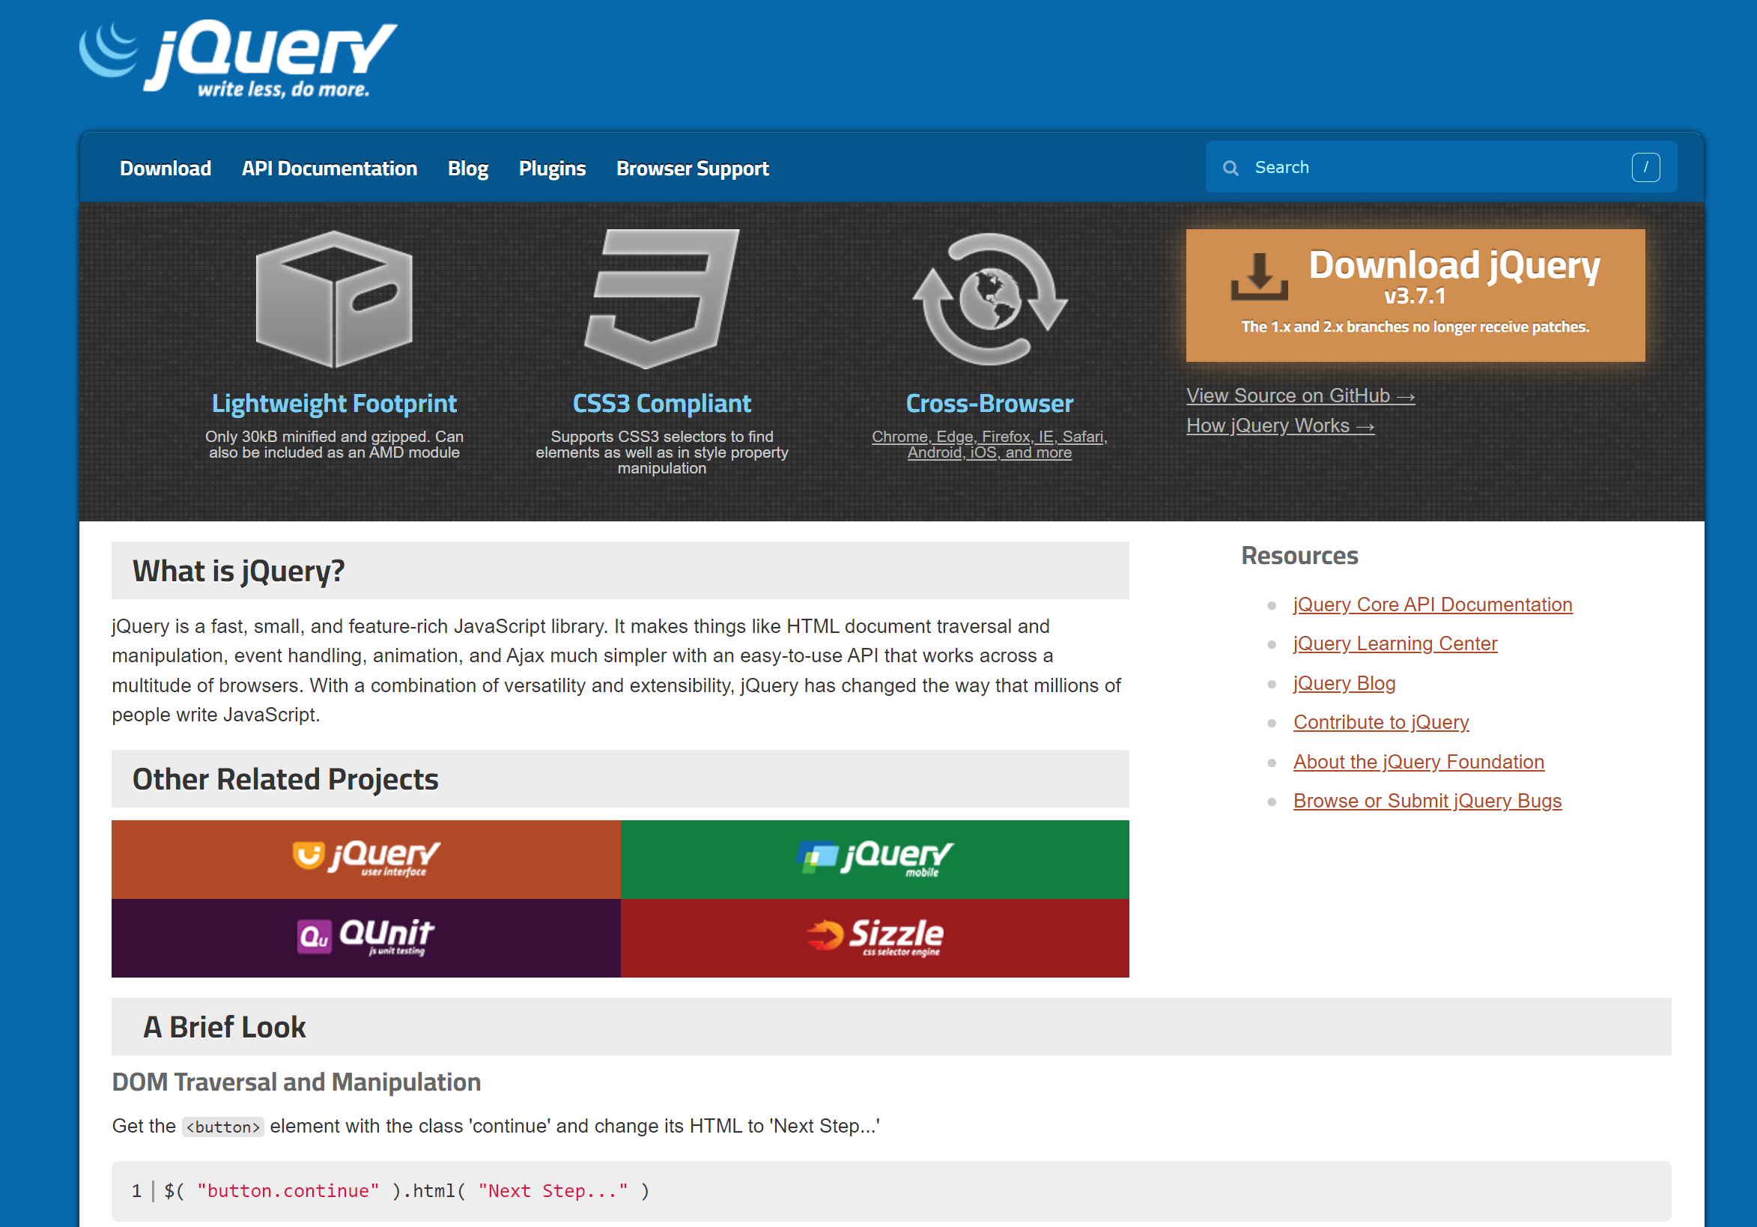
What is jQuery

Slide 3
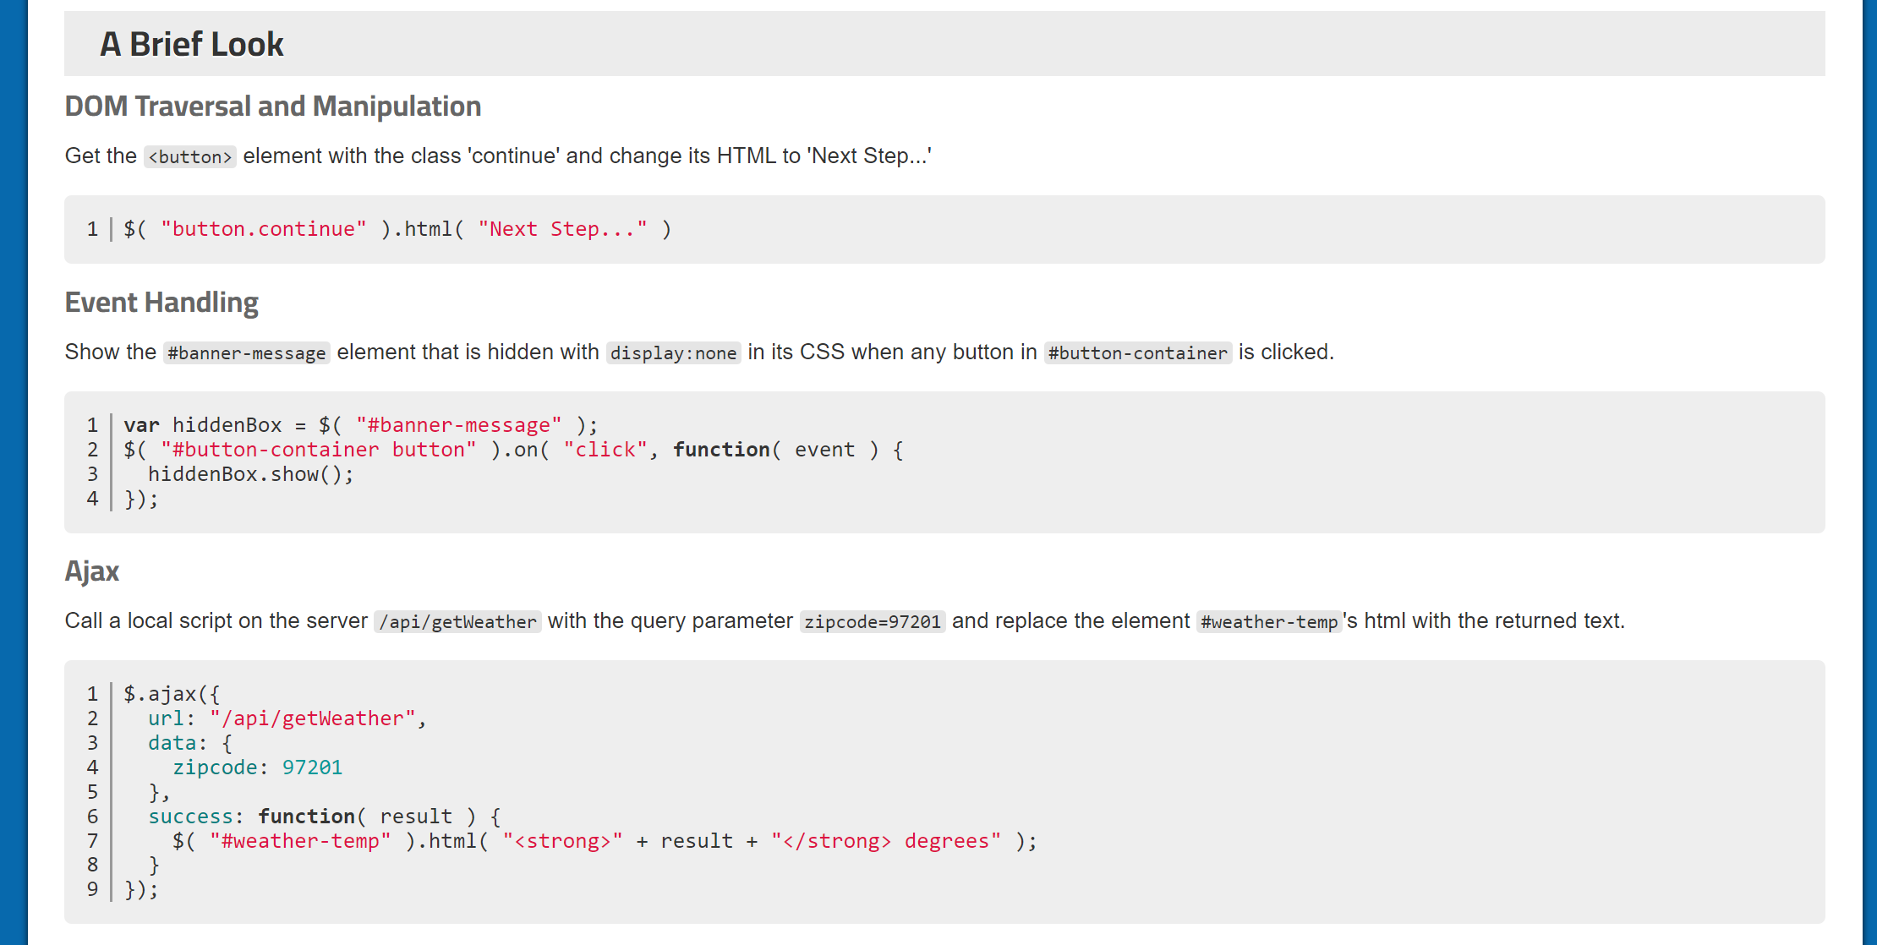
A brief Look

Slide 4
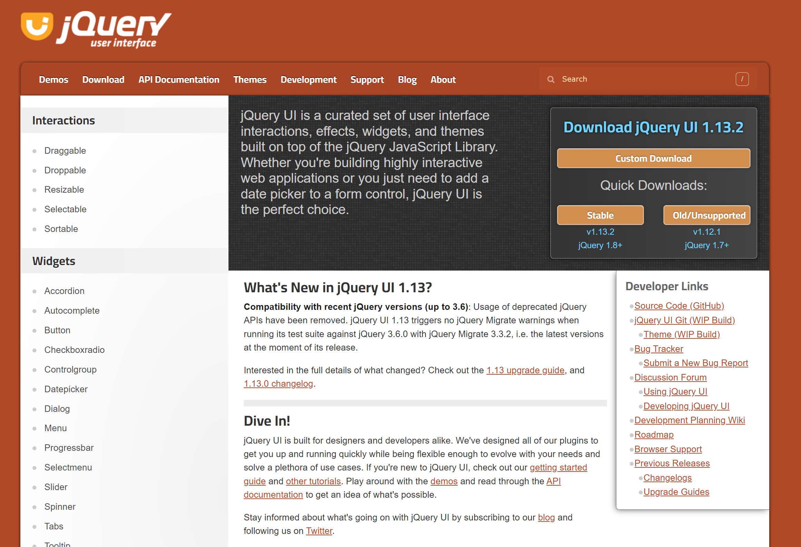
jQuery UI

Slide 5
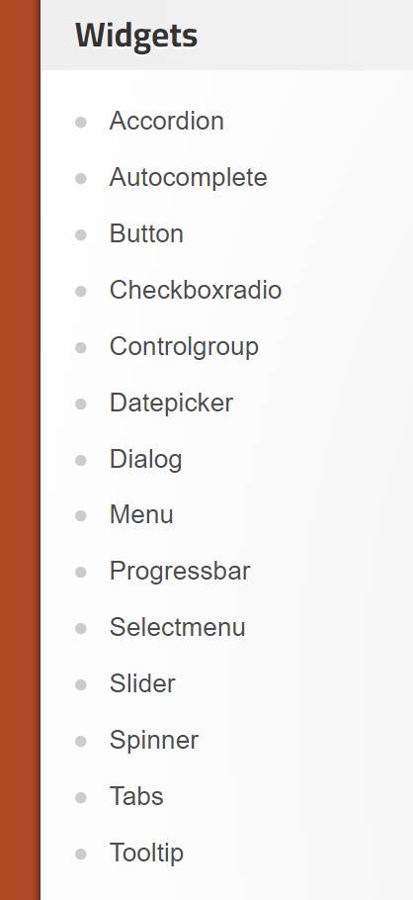
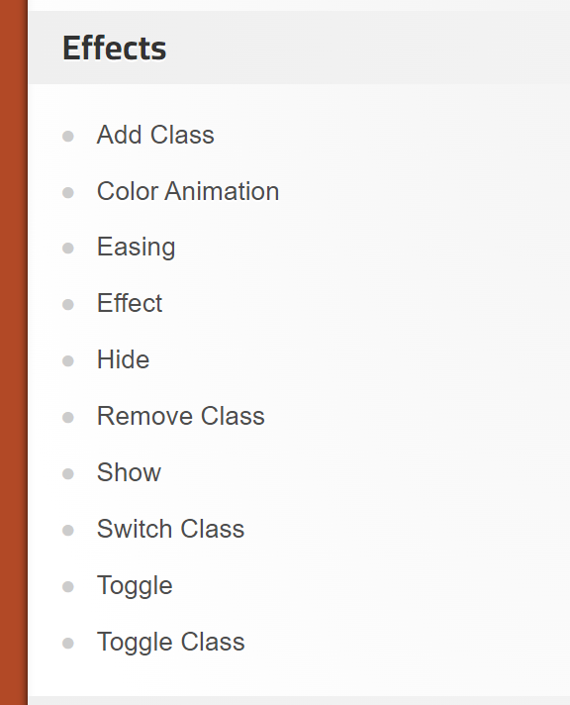
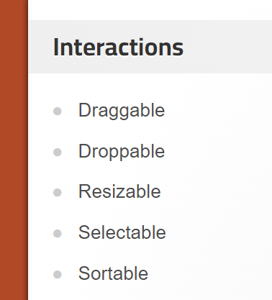
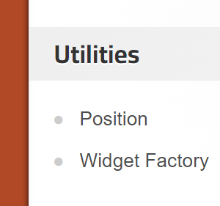
Legacy – Should be replaced by other libs (Bootstrap).

Slide 6
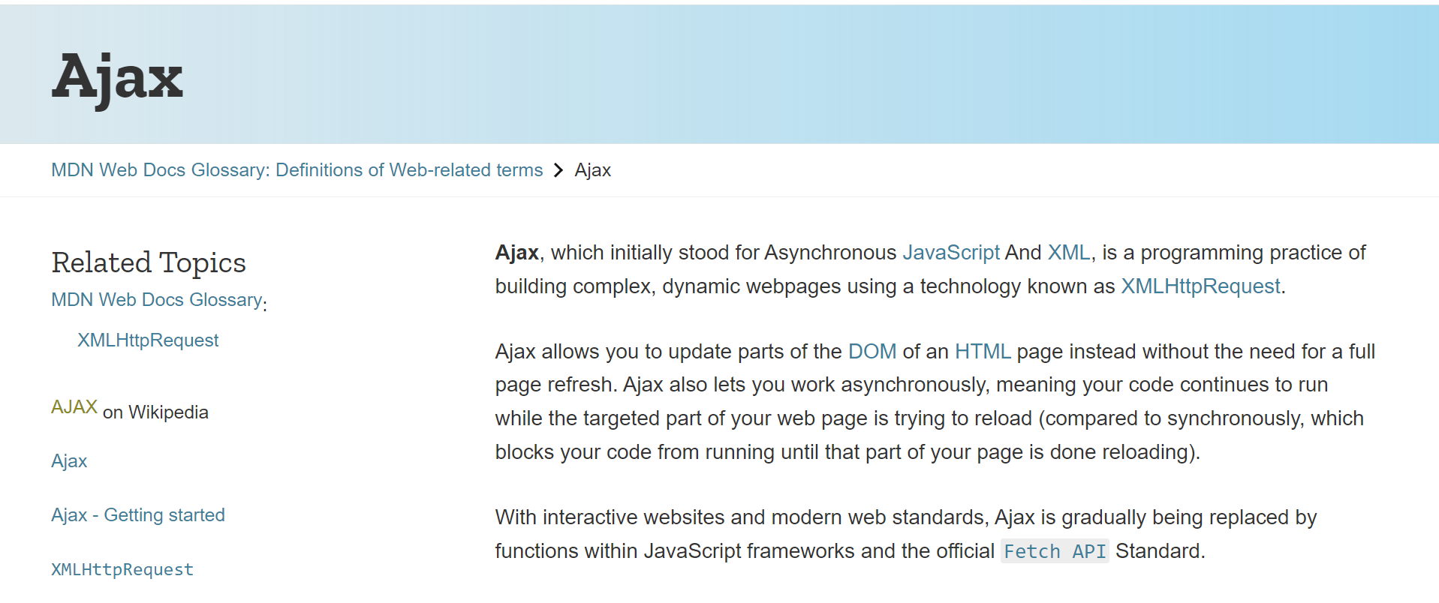
Ajax –Asynchronous JavaScript and XML

Slide 7
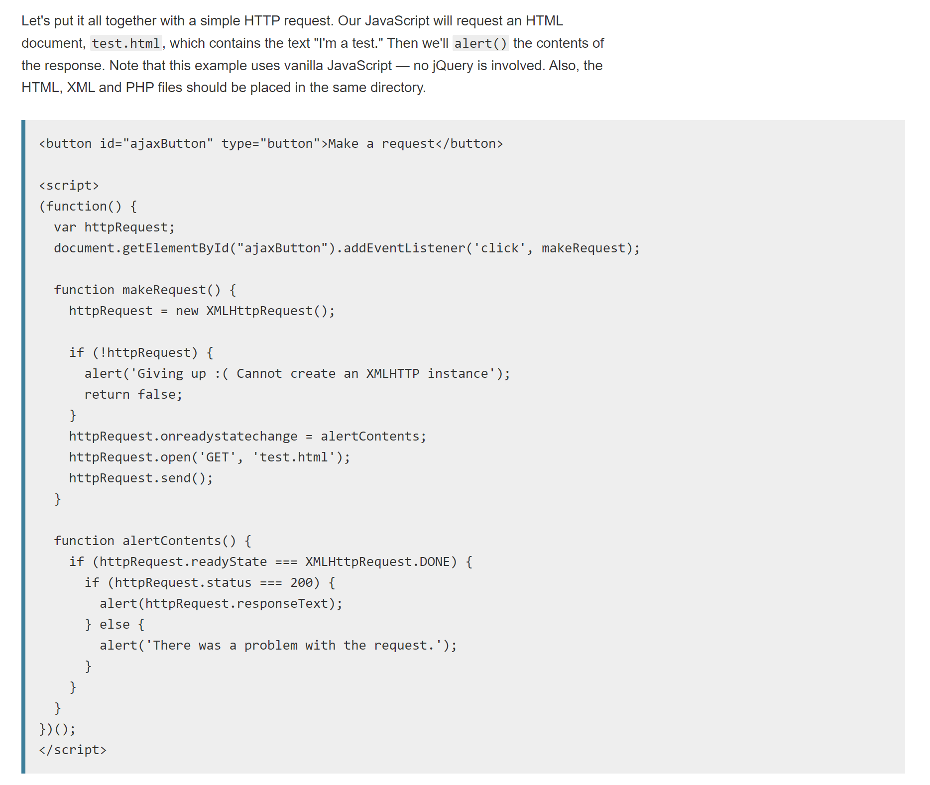
A Simple Example

Slide 8
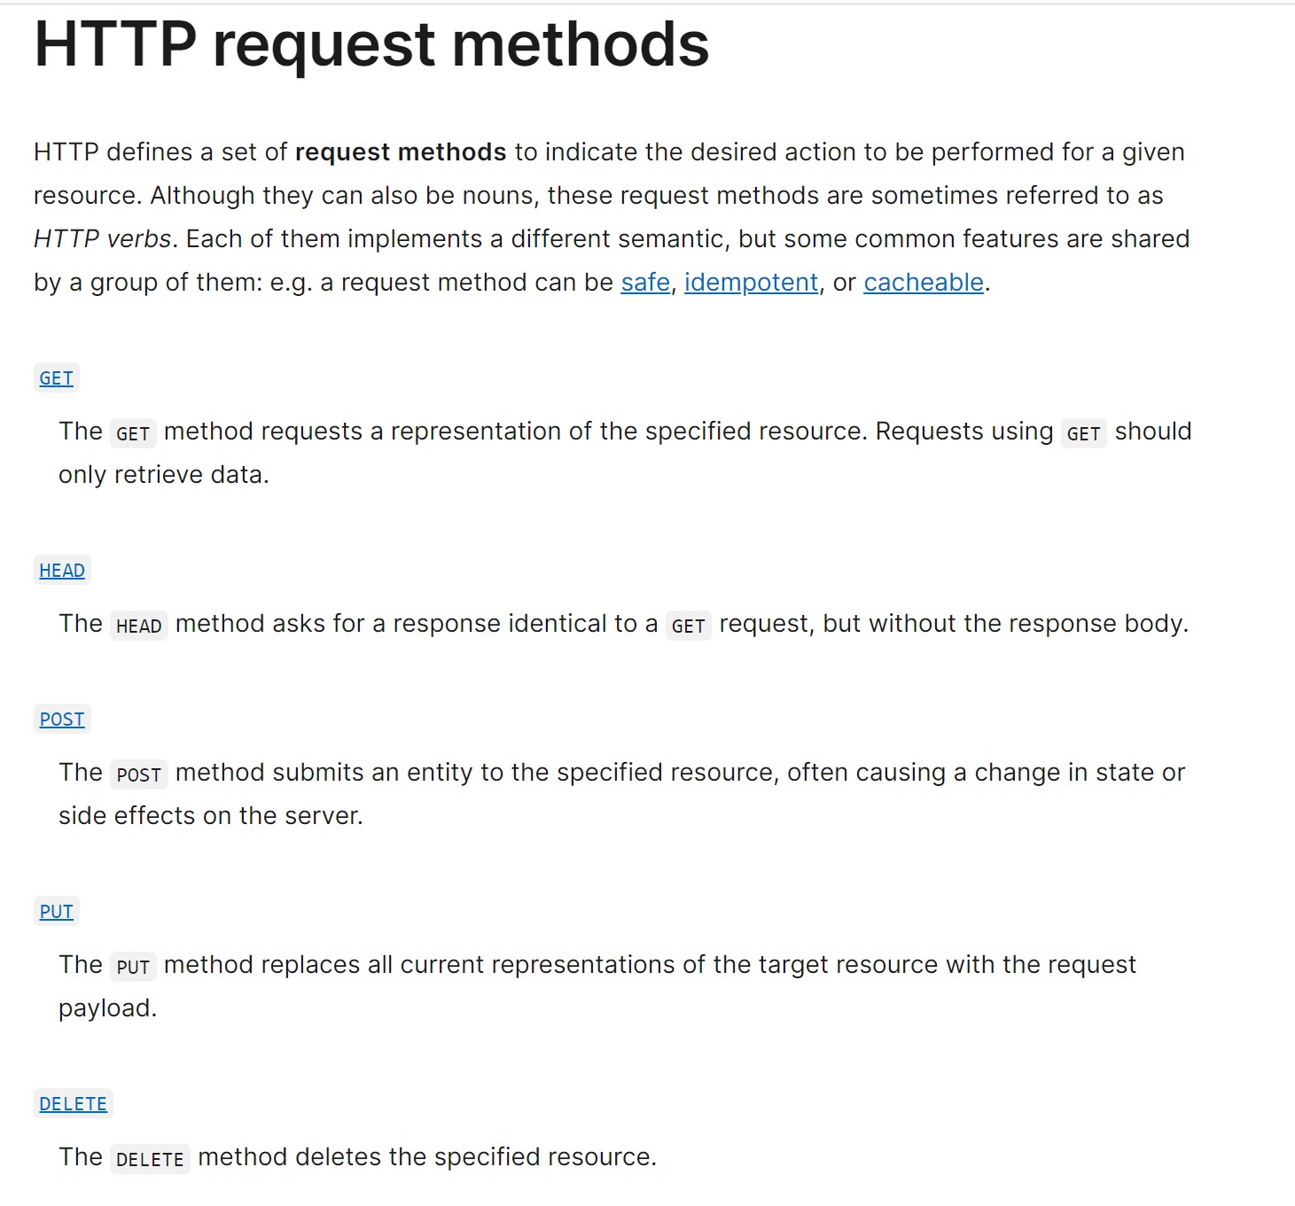
HTTP Verbs

Slide 9
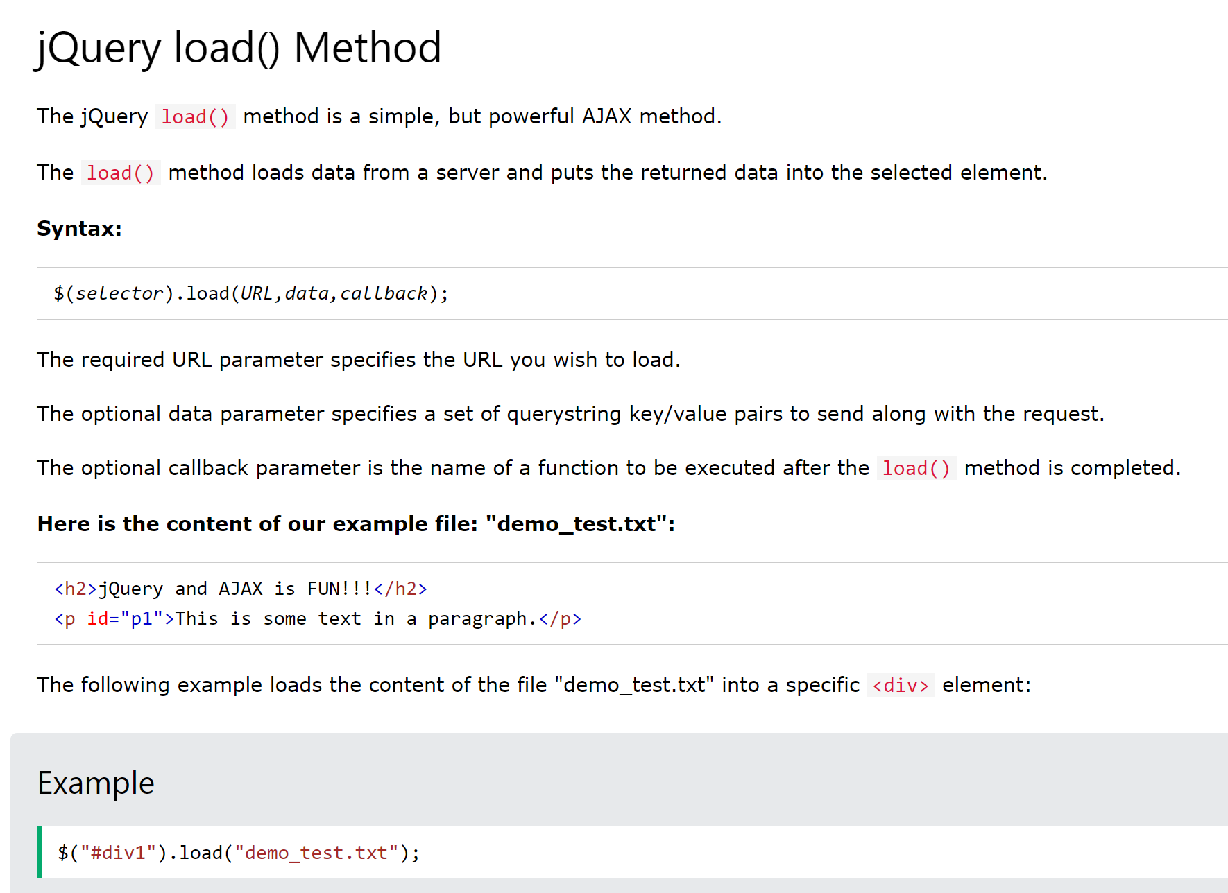
Ajax with jQuery load() method

Slide 10
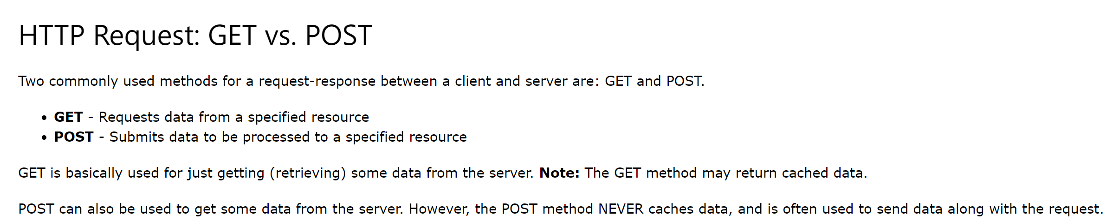
Ajax with jQuery AJAX get() and post() methods

Slide 11
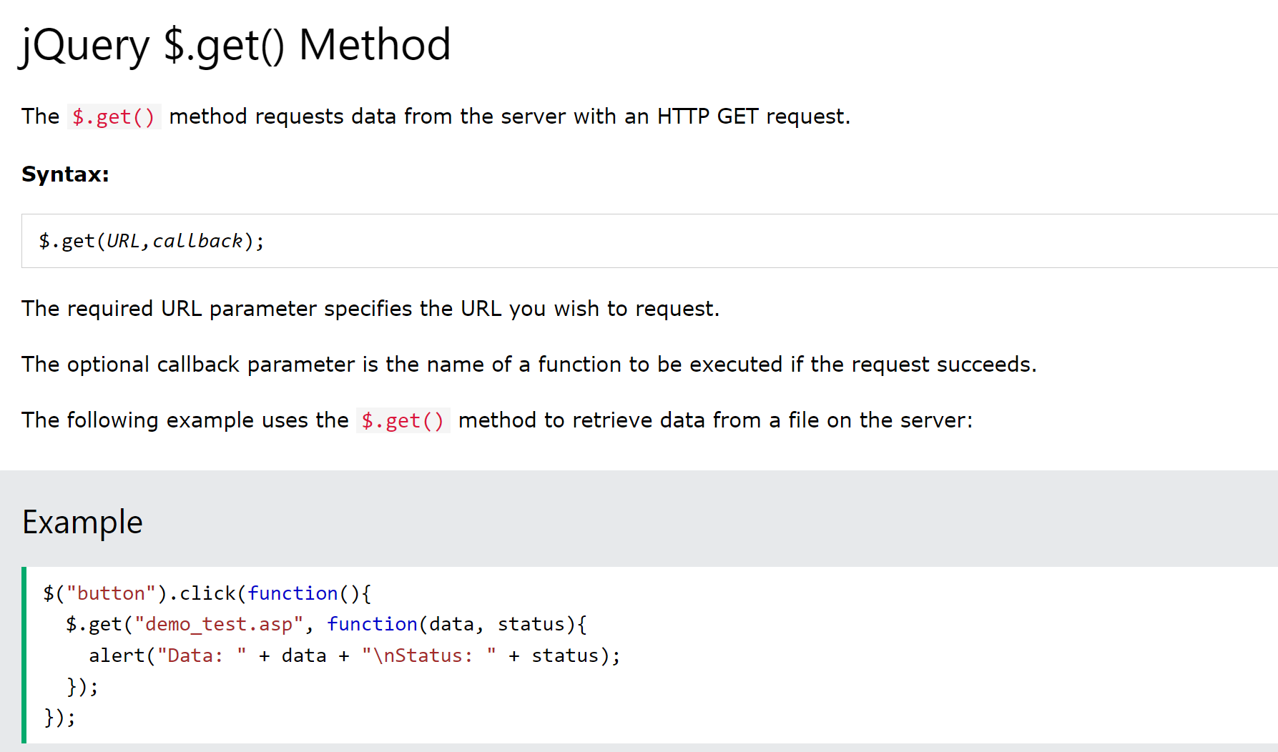
Ajax with jQuery AJAX get() method

Slide 12
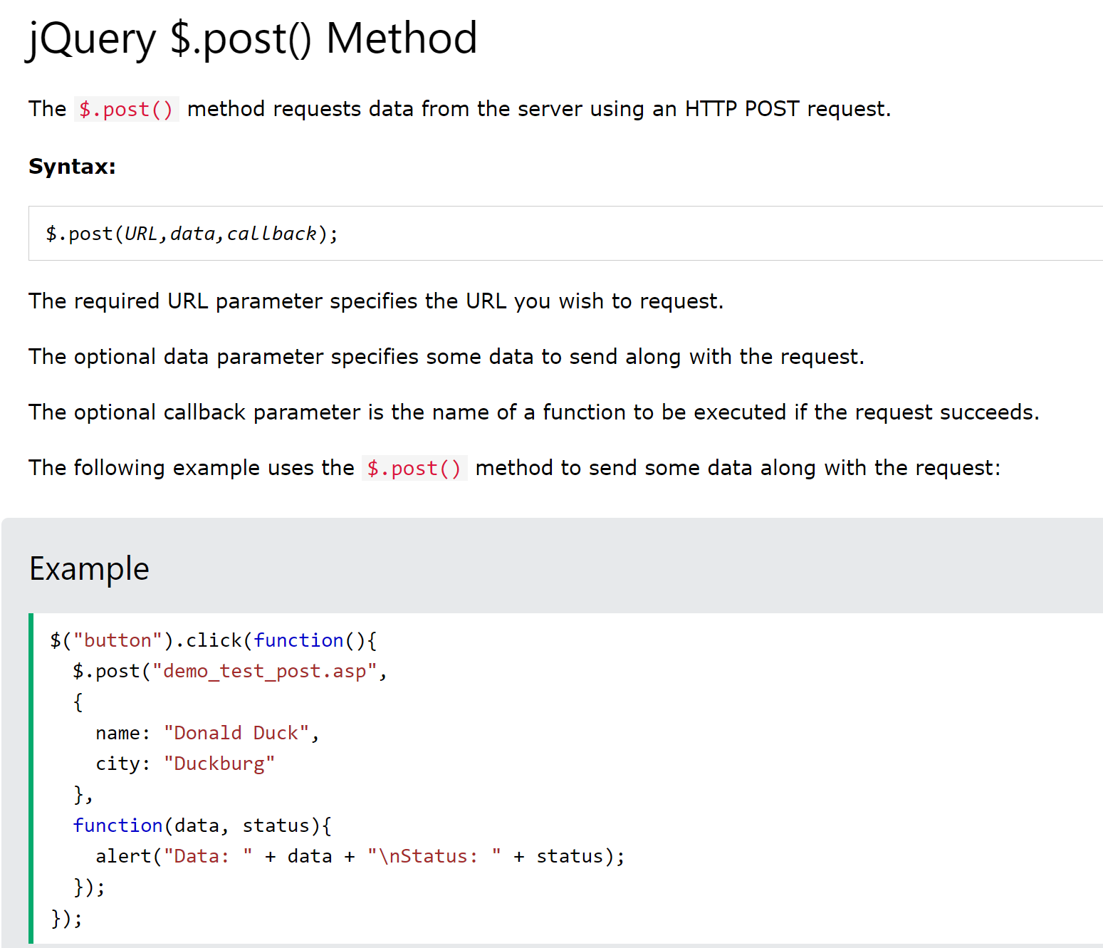
Ajax with jQuery AJAX post() method

Slide 13
Thank you

